Slide 1

PROJECT SUMMARY
Customer Churn Prediction
Using Machine Learning
Accurately predicting attrition to improve retention and profitability using advanced classification models.

Slide 2







Business Objectives
Predict Churn
Compare Performance
Identify Drivers
Deploy Prototype
Classify customers as likely to churn or remain active using machine learning classification models.
Evaluate models using F1-score and ROC-AUC with optimal decision thresholds.
Determine key factors influencing churn through feature importance analysis.
Deliver a working prototype for the customer retention team to use in real-time.

Slide 3

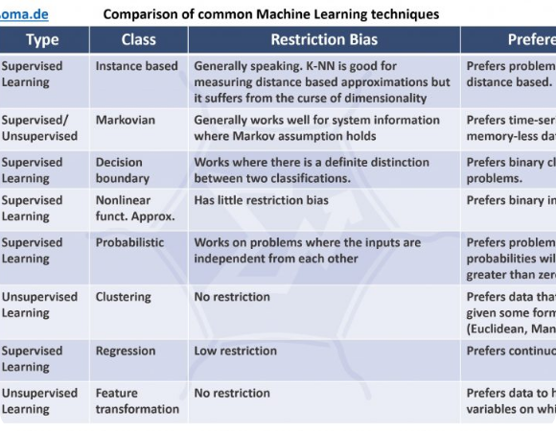
Data Overview & Preprocessing
Key Attributes:
○
Demographics (Age, Gender, Senior Citizen)
○
Account Info (Tenure, Contract, Payment Method)
○
Services (Phone, Internet, Streaming)
Preprocessing Pipeline:
○
Handled missing values & encoded variables
○
Balanced target using class weights
○
Scaled features for Logistic Regression
○
80/20 Train-Test split strategy

Slide 4








Modeling Approach
Logistic Regression
Random Forest
XGBoost
LightGBM
Baseline linear model for establishing initial performance benchmarks.
Ensemble method using bagging to reduce variance and improve stability.
Gradient boosting framework designed for speed and performance.
Tree-based learning algorithm optimized for efficiency and accuracy.
* All models were tuned with threshold optimization to maximize F1-score on the test set.

Slide 5
Model Performance Summary
Model | Test F1 Score | ROC-AUC | Best Threshold
LightGBM | 0.6600 | 0.6400 | 0.99
Random Forest | 0.6562 | 0.6365 | 0.99
XGBoost | 0.6562 | 0.6365 | 0.99
Logistic Regression | 0.6385 | 0.5908 | 0.01

Slide 6
Best Model:
LightGBM
Highest F1-Score (0.66): Superior balance of precision and recall.
Efficiency: Fast training times with excellent generalization.
Robustness: Strong performance even with class imbalance.

Slide 7

Key Insights From the Model LightGBM
Based on the feature importance visualization, the LightGBM model identified the following top predictors of customer churn:
•
Customer Age: Younger Customers churn more.
•
Tenure: New customers are at highest risk.
•
Support Calls: Frequent complaints strongly signal churn .
•
Usage Frequency: Low/declining usage predicts churn.
•
Last Interaction: Customers who have not engaged recently are drifting away.
•
Payment Delay: Late payments correlate with churn.
These features give the business clear, actionable targets for reducing churn.

Slide 8

Strategic Recommendations
Value Optimization
Payment Migration
Review pricing structures for Fiber-optic plans and offer loyalty discounts to offset high monthly charges.
Incentivize customers to switch from Electronic Check to auto-pay methods (Credit Card/Bank Transfer) for better stability.
Contract Incentives
Experience Enhancement
Migrate month-to-month users to annual contracts using limited-time promotions to lock in retention.
Investigate service quality issues specifically within the Fiber-optic segment to address root causes of dissatisfaction.

Slide 9

Conclusion
The project successfully developed a robust machine learning system for predicting customer churn. LightGBM outperformed all other models and is recommended for deployment.
This tool empowers the company to:
•
Reduce churn rates proactively
•
Improve customer satisfaction
•
Increase long-term revenue
•
Make data-driven retention decisions

Slide 10
Q & A
Thank you for your attention.

Slide 11



Image Sources
https://www.aisoma.de/wp-content/uploads/2019/09/ML_techniques-1024x561.jpg
Source: www.aisoma.de
https://electricway.com/wp-content/uploads/2023/07/fiber-optic-cables1-1.jpg
Source: electricway.com
https://media.zoom.com/images/assets/customer-retention-strategies-hero.webp/Zz1iZDVkZDM0NjdjNjYxMWYwYjdlZTg2N2I3NjhmYjlkZg==
Source: www.zoom.com

